Slide 1

CSE 473
Pattern Recognition

Slide 2
Context Dependent Classification

Slide 3
Context Dependent Classification
Recall context free classification
  No relation exist among classes
  No relation exists among objects (feature vectors)
  A new object is classified to any class independent of the previous objects’ classes

Slide 4
Context Dependent Classification
In Context dependent classification, the class of a feature vector depends on
  Its own value
  Value of other feature vectors
  Classes assigned to other vectors

Slide 5
Context Dependent Classification
Application
  Communication
  Image Processing
  Signal Processing

Slide 6
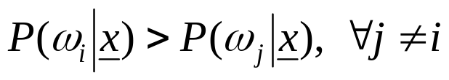
Solution for Context Dependent Classification
Recall Bayesian formulation for context free classification
  Assign x to ω_{i} if
In context dependent classification, we cannot apply it directly because of interdependency of features and classes

Slide 7
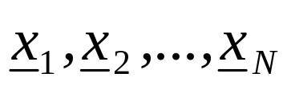
Solution for Context Dependent Classification
This interrelation demands the classification to be performed simultaneously for all available feature vectors
we assume that the training vectors
occur in sequence, one after the other and we will refer to them as observations

Slide 8
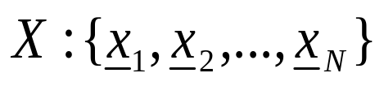



Context Dependent Bayesian Classifier
Let be sequence of observations
Let be the available M classes
Let be a possible sequence of assigned classes, that is
  where,
There are M^{N} of

Slide 9
Context Dependent Bayesian Classifier
Now, given and
Classify X to using the Bayesian rule
This is equivalent to classifying

Slide 10
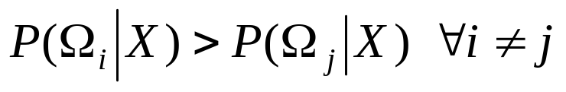

Context Dependent Bayesian Classifier
The rule
can be simplified as

Slide 11
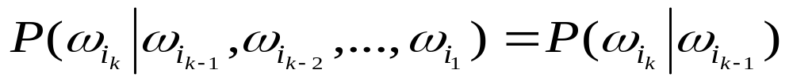
Further Simplification: Markov Chain Model
Markov Chain Models (for class dependence)
which means class dependence is limited to only within two successive classes

Slide 12
Further Simplification: Markov Chain Model
Markov Chain Models (for class dependence)
in other words,
if
then
depends on the class from which observation x_{k-1}, at stage k-1 has occurred

Slide 13

Further Simplification: Markov Chain Model
Markov Chain Models (for class dependence)
Therefore, we can write

Slide 14

Further Simplification: Markov Chain Model
Markov Chain Models (for class dependence)
Therefore, we can write
We find,

Slide 15

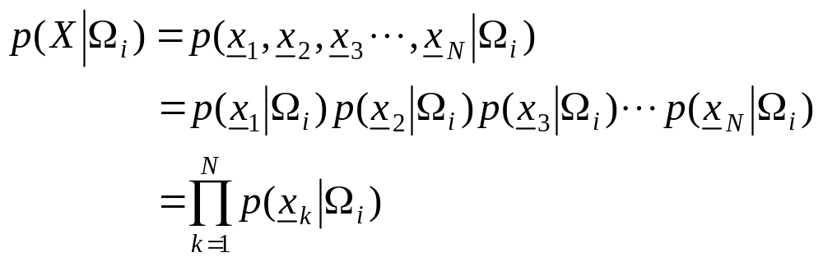
Further Simplification: Markov Chain Model
Further assumption
  statistically mutually independent

Slide 16
Further Simplification: Markov Chain Model
Further assumption
  statistically mutually independent
  If the pdf in one class is independent of the others, then

Slide 17
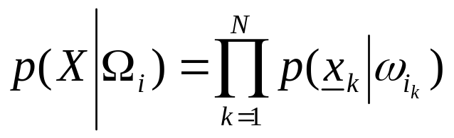
Further Simplification: Markov Chain Model
Further assumption
  statistically mutually independent
  The pdf in one class independent of the others, then
  Finally,

Slide 18
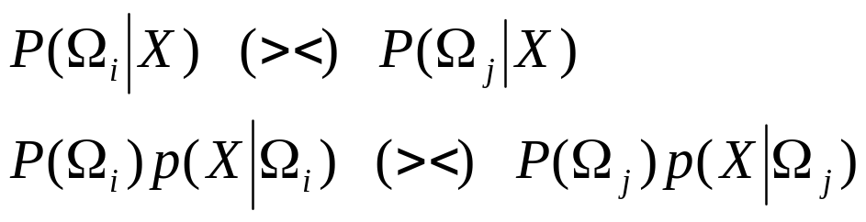
Further Simplification: Markov Chain Model
From the above, the Bayes rule is readily seen to be equivalent to:

Slide 19
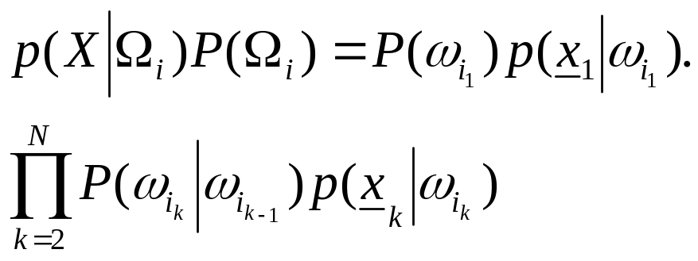
Further Simplification: Markov Chain Model
From the above, the Bayes rule is readily seen to be equivalent to:
that is, it turns to:

Slide 20
Further Simplification: Markov Chain Model
From the above, the Bayes rule is readily seen to be equivalent to:
that is, it rests on
To find the above maximum in brute-force task we need Ο(NM^{Ν} ) operations!!

Slide 21
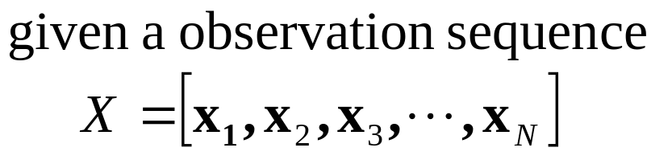
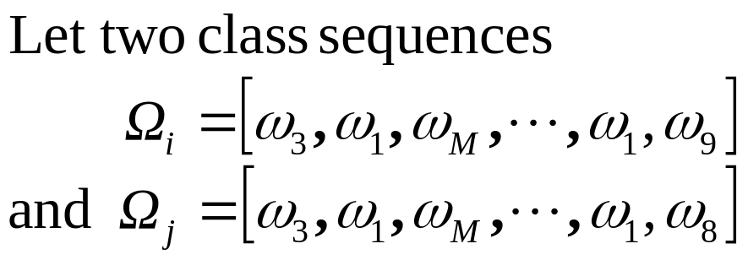
Further Simplification: Markov Chain Model

Slide 22
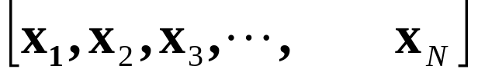
Further Simplification: Markov Chain Model

Slide 23
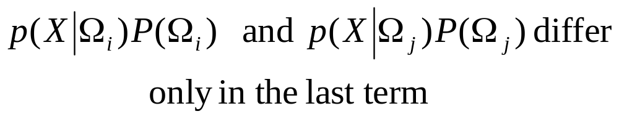
Further Simplification: Markov Chain Model

Slide 24
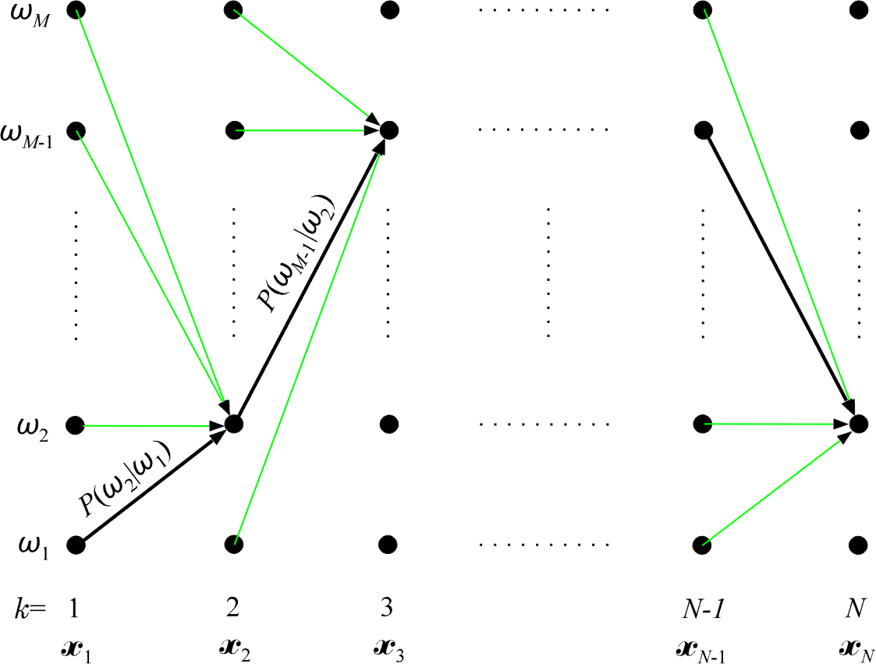
Viterbi Algorithm: Calculate p(X|Ω_{i})p(Ω_{i})

Slide 25
Viterbi Algorithm: Calculate p(X|Ω_{i})p(Ω_{i})
N dot columns
M possible classes
Successive columns correspond to successive observations x_{k}, k= 1, 2, …, N
Each of the class sequences Ω_{i} corresponds to a specific path of successive transitions

Slide 26
Viterbi Algorithm: Calculate p(X|Ω_{i})p(Ω_{i})
Each transition from class ω_{i} to ω_{j} has a fixed probability P(ω_{j} | ω_{i} )
Also, assume p(x| ω_{i} ) is known

Slide 27
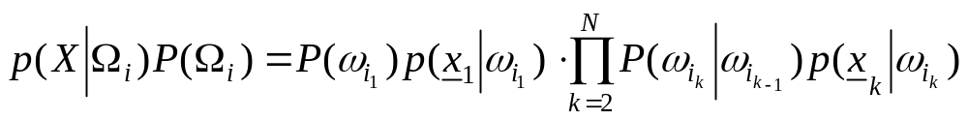
Viterbi Algorithm: Calculate p(X|Ω_{i})p(Ω_{i})
Now the problem can be stated as,
Given a sequence of observations x₁, x₂, . . . , x_{N}, find the path of successive (class) transitions that maximizes

Slide 28
Viterbi Algorithm: Calculate p(X|Ω_{i})p(Ω_{i})
Now the problem can be stated as,
Given a sequence of observations x₁, x₂, . . . , x_{N}, find the path of successive (class) transitions that maximizes
That is, find an optimal path (e. g., the black line)

Slide 29
Viterbi Algorithm: Calculate p(X|Ω_{i})p(Ω_{i})
The classes along this optimal path are the classes of the respective observations.

Slide 30
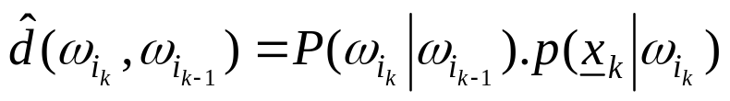
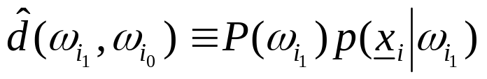
Viterbi Algorithm: Calculate p(X|Ω_{i})p(Ω_{i})
Looking at
The cost of a transition is
And the cost at initial transition
is

Slide 31
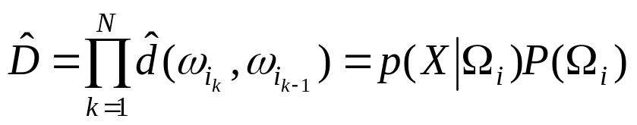
Viterbi Algorithm: Calculate p(X|Ω_{i})p(Ω_{i})
Using the notations
and
The equation
can be written as

Slide 32


Viterbi Algorithm: Calculate p(X|Ω_{i})p(Ω_{i})
The equation
can be written as

Slide 33
Viterbi Algorithm: Calculate p(X|Ω_{i})p(Ω_{i})
The equation
can be written as
We can use Bellman’s optimality principle!!!

Slide 34

Viterbi Algorithm: Calculate p(X|Ω_{i})p(Ω_{i})
To use Bellman’s theorem
  Define the cost up to node k as

Slide 35
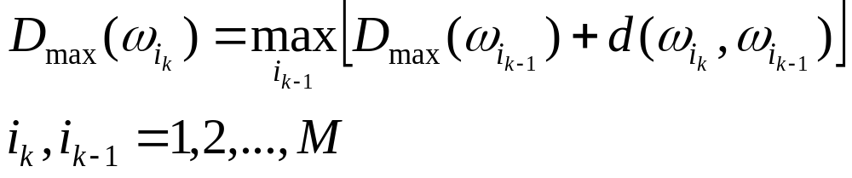

Viterbi Algorithm: Calculate p(X|Ω_{i})p(Ω_{i})
To use Bellman’s theorem
  Define the cost up to node k as
  Bellman’s principle now states
with

Slide 36

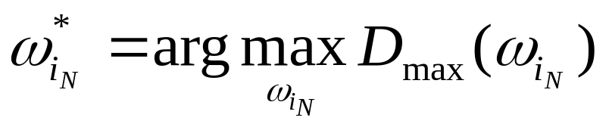
Viterbi Algorithm: Calculate p(X|Ω_{i})p(Ω_{i})
  Bellman’s principle now states
with
  Finally, the optimal path terminates at

Slide 37
Viterbi Algorithm: Calculate p(X|Ω_{i})p(Ω_{i})
    Total M nodes in each of N columns
    Each node has M transitions
    Thus, complexity is O (NM²)

Slide 38
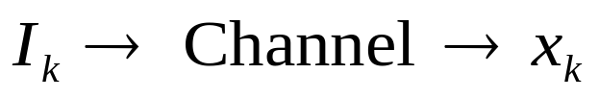
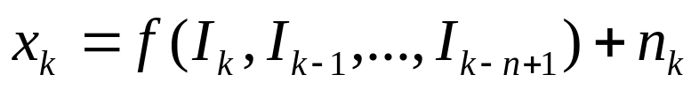
Application in Channel Equalization
The problem
  Information bits I_{k} are transmitted
  We receive x_{k}
    where, f is the action of channel
    n_{k} is the noise

Slide 39
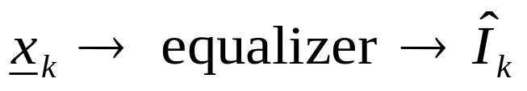
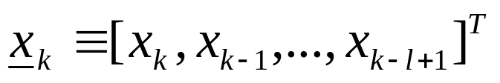
Application in Channel Equalization
We want the bits back
where,

Slide 40
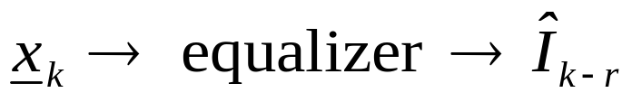
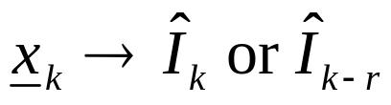
Application in Channel Equalization
We want the bits back
OR if we allow delay r

Slide 41

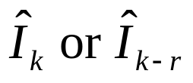
Application in Channel Equalization
We want the bits back
OR if we allow delay r
This means we use the vector to get a single bit

Slide 42
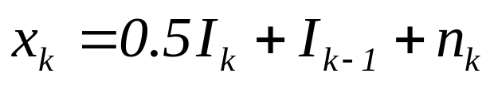
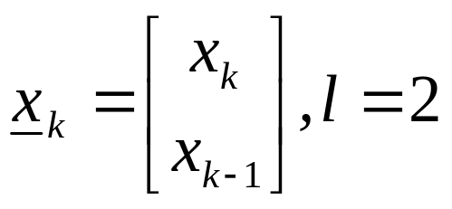
Application in Channel Equalization
Example
    In vector x_{k} three input symbols are involved:
    I_{k}, I_{k-1}, I_{k-2}

Slide 43

Application in Channel Equalization
Assuming n_{k} =0
I_{k} | I_{k-1} | I_{k-2}
0 | 0 | 0
0 | 0 | 1
0 | 1 | 0
0 | 1 | 1
1 | 0 | 0
1 | 0 | 1
1 | 1 | 0
1 | 1 | 1

Slide 44
Application in Channel Equalization
Assuming n_{k} =0
 |  | I_{k-2}
 |  | 0
 |  | 1
 |  | 0
 |  | 1
 |  | 0
 |  | 1
 |  | 0
 |  | 1

Slide 45
Application in Channel Equalization
Assuming n_{k} =0
 | I_{k-1} | I_{k-2}
 | 0 | 0
 | 0 | 1
 | 1 | 0
 | 1 | 1
 | 0 | 0
 | 0 | 1
 | 1 | 0
 | 1 | 1

Slide 46
Application in Channel Equalization
Assuming n_{k} =0
I_{k} | I_{k-1} | I_{k-2}
0 | 0 | 0
0 | 0 | 1
0 | 1 | 0
0 | 1 | 1
1 | 0 | 0
1 | 0 | 1
1 | 1 | 0
1 | 1 | 1

Slide 47


Application in Channel Equalization
Assuming n_{k} =0
 | I_{k-1} | I_{k-2} |  | x_{k-1}
0 | 0 | 0 | 0 | 0 | ω₁
0 | 0 | 1 | 0 | 1 | ω₂
0 | 1 | 0 | 1 | 0.5 | ω₃
0 | 1 | 1 | 1 | 1.5 | ω₄
1 | 0 | 0 | 0.5 | 0 | ω₅
1 | 0 | 1 | 0.5 | 1 | ω₆
1 | 1 | 0 | 1.5 | 0.5 | ω₇
1 | 1 | 1 | 1.5 | 1.5 | ω₈

Slide 48


Application in Channel Equalization
Assuming n_{k} =0
I_{k} | I_{k-1} | I_{k-2} | x_{k} | x_{k-1}
0 | 0 | 0 | 0 | 0 | ω₁
0 | 0 | 1 | 0 | 1 | ω₂
0 | 1 | 0 | 1 | 0.5 | ω₃
0 | 1 | 1 | 1 | 1.5 | ω₄
1 | 0 | 0 | 0.5 | 0 | ω₅
1 | 0 | 1 | 0.5 | 1 | ω₆
1 | 1 | 0 | 1.5 | 0.5 | ω₇
1 | 1 | 1 | 1.5 | 1.5 | ω₈

Slide 49
Application in Channel Equalization
Assuming n_{k} =0
Estimate I_{k} from (x_{k}, x_{k-1})
I_{k} | I_{k-1} | I_{k-2} | x_{k} | x_{k-1}
0 | 0 | 0 | 0 | 0 | ω₁
0 | 0 | 1 | 0 | 1 | ω₂
0 | 1 | 0 | 1 | 0.5 | ω₃
0 | 1 | 1 | 1 | 1.5 | ω₄
1 | 0 | 0 | 0.5 | 0 | ω₅
1 | 0 | 1 | 0.5 | 1 | ω₆
1 | 1 | 0 | 1.5 | 0.5 | ω₇
1 | 1 | 1 | 1.5 | 1.5 | ω₈

Slide 50
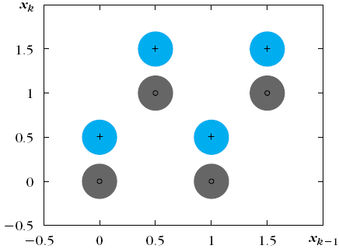
Application in Channel Equalization
Assuming n_{k} =0
I_{k} | I_{k-1} | I_{k-2} | x_{k} | x_{k-1}
0 | 0 | 0 | 0 | 0 | ω₁
0 | 0 | 1 | 0 | 1 | ω₂
0 | 1 | 0 | 1 | 0.5 | ω₃
0 | 1 | 1 | 1 | 1.5 | ω₄
1 | 0 | 0 | 0.5 | 0 | ω₅
1 | 0 | 1 | 0.5 | 1 | ω₆
1 | 1 | 0 | 1.5 | 0.5 | ω₇
1 | 1 | 1 | 1.5 | 1.5 | ω₈
+
+
_{º}
_{º}
+
+
_{º}
_{º}
Eight possible clusters

Slide 51
Application in Channel Equalization
Assuming n_{k} =0
I_{k} | I_{k-1} | I_{k-2} | x_{k} | x_{k-1}
0 | 0 | 0 | 0 | 0 | ω₁
0 | 0 | 1 | 0 | 1 | ω₂
0 | 1 | 0 | 1 | 0.5 | ω₃
0 | 1 | 1 | 1 | 1.5 | ω₄
1 | 0 | 0 | 0.5 | 0 | ω₅
1 | 0 | 1 | 0.5 | 1 | ω₆
1 | 1 | 0 | 1.5 | 0.5 | ω₇
1 | 1 | 1 | 1.5 | 1.5 | ω₈
+
+
_{º}
_{º}
+
+
_{º}
_{º}
‘+’ means I_{k} was 1, ‘o’ means I_{k} was 0

Slide 52
Application in Channel Equalization
I_{k} | I_{k-1} | I_{k-2} | x_{k} | x_{k-1}
0 | 0 | 0 | 0 | 0 | ω₁
0 | 0 | 1 | 0 | 1 | ω₂
0 | 1 | 0 | 1 | 0.5 | ω₃
0 | 1 | 1 | 1 | 1.5 | ω₄
1 | 0 | 0 | 0.5 | 0 | ω₅
1 | 0 | 1 | 0.5 | 1 | ω₆
1 | 1 | 0 | 1.5 | 0.5 | ω₇
1 | 1 | 1 | 1.5 | 1.5 | ω₈
Big cluster exists when the noise n_{k} is NOT 0 (zero)

Slide 53
Application in Channel Equalization
I_{k} | I_{k-1} | I_{k-2} | x_{k} | x_{k-1}
0 | 0 | 0 | 0 | 0 | ω₁
0 | 0 | 1 | 0 | 1 | ω₂
0 | 1 | 0 | 1 | 0.5 | ω₃
0 | 1 | 1 | 1 | 1.5 | ω₄
1 | 0 | 0 | 0.5 | 0 | ω₅
1 | 0 | 1 | 0.5 | 1 | ω₆
1 | 1 | 0 | 1.5 | 0.5 | ω₇
1 | 1 | 1 | 1.5 | 1.5 | ω₈
Estimate from (x_{k}, x_{k-1})
A two class problem
Each class is a union of clusters

Slide 54
Solution (1)
I_{k} | I_{k-1} | I_{k-2} | x_{k} | x_{k-1}
0 | 0 | 0 | 0 | 0 | ω₁
0 | 0 | 1 | 0 | 1 | ω₂
0 | 1 | 0 | 1 | 0.5 | ω₃
0 | 1 | 1 | 1 | 1.5 | ω₄
1 | 0 | 0 | 0.5 | 0 | ω₅
1 | 0 | 1 | 0.5 | 1 | ω₆
1 | 1 | 0 | 1.5 | 0.5 | ω₇
1 | 1 | 1 | 1.5 | 1.5 | ω₈
During training,
  send all values of (I_{k-2}, I_{k-1}, I_{k}) and calculate (x_{k-1}, x_{k})
  Calculate the cluster centers μ_{k}
  Assign the bit I_{k} to the cluster μ_{k}

Slide 55
Solution (1)
I_{k} | I_{k-1} | I_{k-2} | x_{k} | x_{k-1}
? |  |  | 0 | 0 | ω₁
? |  |  | 0 | 1 | ω₂
? |  |  | 1 | 0.5 | ω₃
? |  |  | 1 | 1.5 | ω₄
? |  |  | 0.5 | 0 | ω₅
? |  |  | 0.5 | 1 | ω₆
? |  |  | 1.5 | 0.5 | ω₇
? |  |  | 1.5 | 1.5 | ω₈
During equalization (testing),
  Get (x_{k-1}, x_{k}) from the channel
  Find the nearest cluster μ_{i}
  The bit of μ_{i} is the estimated transmitted bit

Slide 56

Solution (2)
I_{k} | I_{k-1} | I_{k-2} | x_{k} | x_{k-1}
0 | 0 | 0 | 0 | 0 | ω₁
0 | 0 | 1 | 0 | 1 | ω₂
0 | 1 | 0 | 1 | 0.5 | ω₃
0 | 1 | 1 | 1 | 1.5 | ω₄
1 | 0 | 0 | 0.5 | 0 | ω₅
1 | 0 | 1 | 0.5 | 1 | ω₆
1 | 1 | 0 | 1.5 | 0.5 | ω₇
1 | 1 | 1 | 1.5 | 1.5 | ω₈
Let
  which corresponds to ω₂

Slide 57
Solution (2)
I_{k} | I_{k-1} | I_{k-2} | x_{k} | x_{k-1}
0 | 0 | 0 | 0 | 0 | ω₁
0 | 0 | 1 | 0 | 1 | ω₂
0 | 1 | 0 | 1 | 0.5 | ω₃
0 | 1 | 1 | 1 | 1.5 | ω₄
1 | 0 | 0 | 0.5 | 0 | ω₅
1 | 0 | 1 | 0.5 | 1 | ω₆
1 | 1 | 0 | 1.5 | 0.5 | ω₇
1 | 1 | 1 | 1.5 | 1.5 | ω₈
Let
  which corresponds to ω₂

Slide 58
Solution (2)
I_{k+1} | I_{k} | I_{k-1} | I_{k-2} | x_{k} | x_{k-1}
? | 0 | 0 | 0 | 0 | 0 | ω₁
? | 0 | 0 | 1 | 0 | 1 | ω₂
? | 0 | 1 | 0 | 1 | 0.5 | ω₃
? | 0 | 1 | 1 | 1 | 1.5 | ω₄
? | 1 | 0 | 0 | 0.5 | 0 | ω₅
? | 1 | 0 | 1 | 0.5 | 1 | ω₆
? | 1 | 1 | 0 | 1.5 | 0.5 | ω₇
? | 1 | 1 | 1 | 1.5 | 1.5 | ω₈
Let
  which corresponds to ω₂
What will be the next bit I_{k+1}

Slide 59

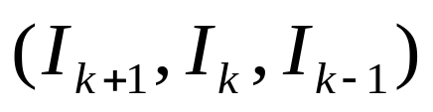
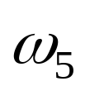


Solution (2)
I_{k+1} | I_{k} | I_{k-1} | I_{k-2} | x_{k} | x_{k-1}
? | 0 | 0 | 0 | 0 | 0 | ω₁
0, 1 | 0 | 0 | 1 | 0 | 1 | ω₂
? | 0 | 1 | 0 | 1 | 0.5 | ω₃
? | 0 | 1 | 1 | 1 | 1.5 | ω₄
? | 1 | 0 | 0 | 0.5 | 0 | ω₅
? | 1 | 0 | 1 | 0.5 | 1 | ω₆
? | 1 | 1 | 0 | 1.5 | 0.5 | ω₇
? | 1 | 1 | 1 | 1.5 | 1.5 | ω₈
Let
  which corresponds to ω₂
The next bit I_{k+1} can be either 1 or 0

Slide 60
Solution (2)
I_{k+1} | I_{k} | I_{k-1} | I_{k-2} | x_{k} | x_{k-1}
? | 0 | 0 | 0 | 0 | 0 | ω₁
0, 1 | 0 | 0 | 1 | 0 | 1 | ω₂
? | 0 | 1 | 0 | 1 | 0.5 | ω₃
? | 0 | 1 | 1 | 1 | 1.5 | ω₄
? | 1 | 0 | 0 | 0.5 | 0 | ω₅
? | 1 | 0 | 1 | 0.5 | 1 | ω₆
? | 1 | 1 | 0 | 1.5 | 0.5 | ω₇
? | 1 | 1 | 1 | 1.5 | 1.5 | ω₈
This means, all transitions are not possible!!
In other words, after (0, 0, 1) we will find
either (1, 0, 0)
or (0, 0, 0)

Slide 61
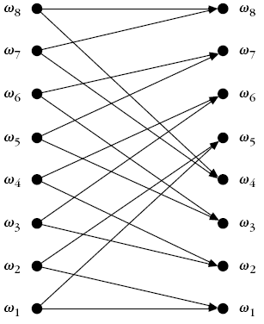
Solution (2)
I_{k+1} | I_{k} | I_{k-1} | I_{k-2} | x_{k} | x_{k-1}
0, 1 | 0 | 0 | 0 | 0 | 0 | ω₁
0, 1 | 0 | 0 | 1 | 0 | 1 | ω₂
0, 1 | 0 | 1 | 0 | 1 | 0.5 | ω₃
0, 1 | 0 | 1 | 1 | 1 | 1.5 | ω₄
0, 1 | 1 | 0 | 0 | 0.5 | 0 | ω₅
0, 1 | 1 | 0 | 1 | 0.5 | 1 | ω₆
0, 1 | 1 | 1 | 0 | 1.5 | 0.5 | ω₇
0, 1 | 1 | 1 | 1 | 1.5 | 1.5 | ω₈
This means, all transitions are NOT possible!!
Alternately, after (0, 0, 1) we can get either (1, 0, 0) or (0, 0,0)

Slide 62
Solution (2)
I_{k+1} | I_{k} | I_{k-1} | I_{k-2} | x_{k} | x_{k-1}
0, 1 | 0 | 0 | 0 | 0 | 0 | ω₁
0, 1 | 0 | 0 | 1 | 0 | 1 | ω₂
0, 1 | 0 | 1 | 0 | 1 | 0.5 | ω₃
0, 1 | 0 | 1 | 1 | 1 | 1.5 | ω₄
0, 1 | 1 | 0 | 0 | 0.5 | 0 | ω₅
0, 1 | 1 | 0 | 1 | 0.5 | 1 | ω₆
0, 1 | 1 | 1 | 0 | 1.5 | 0.5 | ω₇
0, 1 | 1 | 1 | 1 | 1.5 | 1.5 | ω₈
We can use Viterbi algorithm now !!!

Slide 63
Solution (2): Viterbi Algorithm
I_{k+1} | I_{k} | I_{k-1} | I_{k-2} | x_{k} | x_{k-1}
0, 1 | 0 | 0 | 0 | 0 | 0 | ω₁
0, 1 | 0 | 0 | 1 | 0 | 1 | ω₂
0, 1 | 0 | 1 | 0 | 1 | 0.5 | ω₃
0, 1 | 0 | 1 | 1 | 1 | 1.5 | ω₄
0, 1 | 1 | 0 | 0 | 0.5 | 0 | ω₅
0, 1 | 1 | 0 | 1 | 0.5 | 1 | ω₆
0, 1 | 1 | 1 | 0 | 1.5 | 0.5 | ω₇
0, 1 | 1 | 1 | 1 | 1.5 | 1.5 | ω₈
We need to define:
P(ω_{i}| ω_{j})
Cost function

Slide 64
Solution (2): Viterbi Algorithm
I_{k+1} | I_{k} | I_{k-1} | I_{k-2} | x_{k} | x_{k-1}
0, 1 | 0 | 0 | 0 | 0 | 0 | ω₁
0, 1 | 0 | 0 | 1 | 0 | 1 | ω₂
0, 1 | 0 | 1 | 0 | 1 | 0.5 | ω₃
0, 1 | 0 | 1 | 1 | 1 | 1.5 | ω₄
0, 1 | 1 | 0 | 0 | 0.5 | 0 | ω₅
0, 1 | 1 | 0 | 1 | 0.5 | 1 | ω₆
0, 1 | 1 | 1 | 0 | 1.5 | 0.5 | ω₇
0, 1 | 1 | 1 | 1 | 1.5 | 1.5 | ω₈
Assuming equiprobability of the next bit:
  P(ω₁| ω₁) = 0.5 = P(ω₁| ω₅)

Slide 65



Solution (2): Viterbi Algorithm
Cost function of transition
Where, either Euclidean distance
Or Mahalanobis distance
Can be used

Slide 66
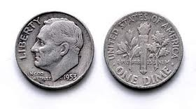
Hidden Markov Model

Slide 67
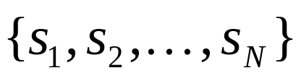
Markov Models
Set of states:

Slide 68
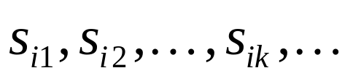
Markov Models
Set of states:
Process moves from one state to another generating a sequence of states :

Slide 69
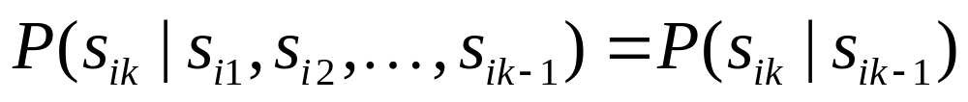
Markov Models
Set of states:
Process moves from one state to another generating a sequence of states :
Markov chain property: probability of each subsequent state depends only on what was the previous state:

Slide 70
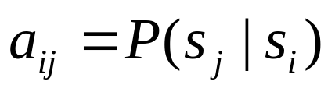
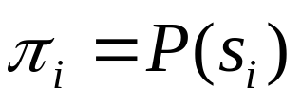
Markov Models
Set of states:
Process moves from one state to another generating a sequence of states :
Markov chain property: probability of each subsequent state depends only on what was the previous state:
To define Markov model, the following probabilities have to be specified: transition probabilities and initial probabilities

Slide 71
Example of Markov Model
0.3
0.7
Rain
Dry
0.2
0.8

Slide 72
Example of Markov Model
0.3
0.7
Rain
Dry
0.2
0.8
Two states : ‘Rain’ and ‘Dry’.

Slide 73
Example of Markov Model
0.3
0.7
Rain
Dry
0.2
0.8
Two states : ‘Rain’ and ‘Dry’.
Transition probabilities:
  P(‘Rain’|‘Rain’)=0.3 , P(‘Dry’|‘Rain’)=0.7 ,
  P(‘Rain’|‘Dry’)=0.2, P(‘Dry’|‘Dry’)=0.8

Slide 74
Example of Markov Model
0.3
0.7
Rain
Dry
0.2
0.8
Two states : ‘Rain’ and ‘Dry’.
Transition probabilities:
  P(‘Rain’|‘Rain’)=0.3 , P(‘Dry’|‘Rain’)=0.7 ,
  P(‘Rain’|‘Dry’)=0.2, P(‘Dry’|‘Dry’)=0.8
Initial probabilities: say P(‘Rain’)=0.4 , P(‘Dry’)=0.6 .

Slide 75
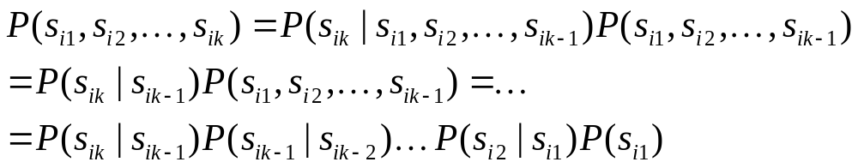
Calculation of sequence probability
By Markov chain property, probability of state sequence can be found by the formula:

Slide 76
Calculation of sequence probability
0.3
0.7
Rain
Dry
0.2
0.8
Suppose we want to calculate a probability of a sequence of states in our example, {‘Dry’,’Dry’,’Rain’,Rain’}.
P({‘Dry’,’Dry’,’Rain’,Rain’} )

Slide 77
Calculation of sequence probability
0.3
0.7
Rain
Dry
0.2
0.8
Suppose we want to calculate a probability of a sequence of states in our example, {‘Dry’,’Dry’,’Rain’,Rain’}.
P({‘Dry’,’Dry’,’Rain’,Rain’} )
= P(‘Rain’|’Rain’) P(‘Rain’|’Dry’) P(‘Dry’|’Dry’) P(‘Dry’)

Slide 78
Calculation of sequence probability
0.3
0.7
Rain
Dry
0.2
0.8
Suppose we want to calculate a probability of a sequence of states in our example, {‘Dry’,’Dry’,’Rain’,Rain’}.
P({‘Dry’,’Dry’,’Rain’,Rain’} )
= P(‘Rain’|’Rain’) P(‘Rain’|’Dry’) P(‘Dry’|’Dry’) P(‘Dry’)
= 0.3*0.2*0.8*0.6

Slide 79
Hidden Markov Model

Slide 80
Hidden Markov Model

Slide 81
Hidden Markov Model
H T H H T T T H H H . . . . .

Slide 82
Hidden Markov Model
H T H H T T T H H H . . . . .
Can we guess which coin is tossed at different times?

Slide 83
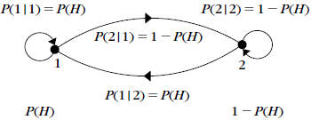
Not A Hidden Markov Model

Slide 84
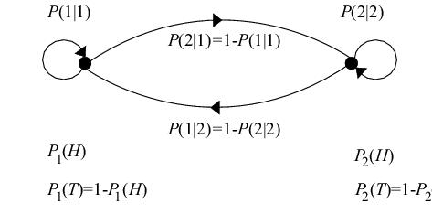
Hidden Markov Model

Slide 85
Hidden Markov models
Set of states:
Process moves from one state to another generating a sequence of states :
Markov chain property: probability of each subsequent state depends only on what was the previous state:

Slide 86
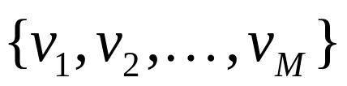
Hidden Markov models
States are not visible, but each state randomly generates one of M observations (or visible states)

Slide 87
Hidden Markov models
States are not visible, but each state randomly generates one of M observations (or visible states)
To define hidden Markov model, the following probabilities have to be specified:
  matrix of transition probabilities A=(a_{ij}), a_{ij}= P(s_{j} | s_{i})
  matrix of observation probabilities B=(b_{i} (v_{m} )),
  where, b_{i}(v_{m} ) =P(v_{m}|s_{i})
  vector of initial probabilities π=(π_{i}), π_{i} = P(s_{i})
Model is represented by M=(A, B, π).

Slide 88
Example of Hidden Markov Model
0.3
0.7
Low
High
0.2
0.8
0.6
0.6
0.4
0.4
Rain
Dry

Slide 89
Example of Hidden Markov Model
0.3
0.7
Low
High
0.2
0.8
0.6
0.6
0.4
0.4
Rain
Dry
Initial probabilities: say P(‘Low’)=0.4 , P(‘High’)=0.6 .

Slide 90
Example of Hidden Markov Model
Two states : ‘Low’ and ‘High’ atmospheric pressure.
Two observations : ‘Rain’ and ‘Dry’.
Transition probabilities: P(‘Low’|‘Low’)=0.3 , P(‘High’|‘Low’)=0.7 , P(‘Low’|‘High’)=0.2, P(‘High’|‘High’)=0.8
Observation probabilities : P(‘Rain’|‘Low’)=0.6 , P(‘Dry’|‘Low’)=0.4 , P(‘Rain’|‘High’)=0.4 , P(‘Dry’|‘High’)=0.3 .
Initial probabilities: say P(‘Low’)=0.4 , P(‘High’)=0.6 .

Slide 91
Calculation of observation sequence probability
Suppose we want to calculate a probability of a sequence of observations in our example, {‘Dry’,’Rain’}.
Consider all possible hidden state sequences:
P({‘Dry’,’Rain’} ) = P({‘Dry’,’Rain’} , {‘Low’,’Low’})
+P({‘Dry’,’Rain’} , {‘Low’,’High’})
+ P({‘Dry’,’Rain’} , {‘High’,’Low’})
+ P({‘Dry’,’Rain’} , {‘High’,’High’})

Slide 92
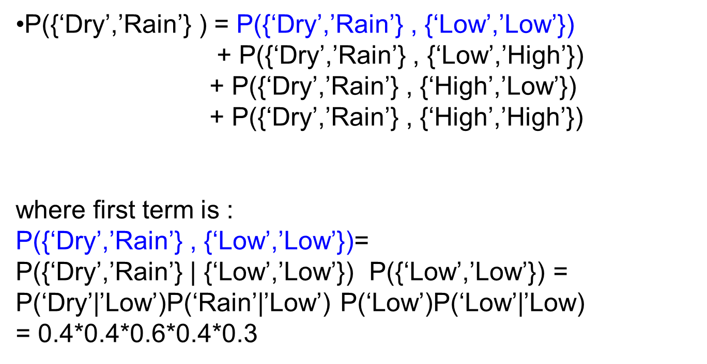
Calculation of observation sequence probability

Slide 93
Main issues using HMMs
Evaluation problem.
Given the HMM M=(A, B, π) and the observation sequence O=o₁ o₂ ... o_{K} , calculate the probability that model M has generated sequence O .
O=o₁...o_{K} denotes a sequence of observations o_{k}∈{v₁,…,v_{M}}.

Slide 94
Main issues using HMMs
Decoding problem.
Given the HMM M=(A, B, π) and the observation sequence O=o₁ o₂ ... o_{K} , calculate the most likely sequence of hidden states s_{i} that produced this observation sequence O.
O=o₁...o_{K} denotes a sequence of observations o_{k}∈{v₁,…,v_{M}}.

Slide 95
Main issues using HMMs
Learning problem.
Given some training observation sequences O=o₁ o₂ ... o_{K} and general structure of HMM (numbers of hidden and visible states), determine HMM parameters M=(A, B, π) that best fit training data.
O=o₁...o_{K} denotes a sequence of observations o_{k}∈{v₁,…,v_{M}}.

Slide 96
The evaluation Problem
Given the HMM M=(A, B, π) and the observation sequence O=o₁ o₂ ... o_{K} , calculate the probability that model M has generated sequence O.
where, O=o₁...o_{K} denotes a sequence of observations o_{k}∈{v₁,…,v_{M}}.

Slide 97
The evaluation Problem
Given the HMM M=(A, B, π) and the observation sequence O=o₁ o₂ ... o_{K} , calculate the probability that model M has generated sequence O.
where, O=o₁...o_{K} denotes a sequence of observations o_{k}∈{v₁,…,v_{M}}.
Alternately, find P(O|M) or P(o₁ o₂ ... o_{K}|M)

Slide 98
The evaluation Problem
Given the HMM M=(A, B, π) and the observation sequence O=o₁ o₂ ... o_{K} , calculate the probability that model M has generated sequence O.
where, O=o₁...o_{K} denotes a sequence of observations o_{k}∈{v₁,…,v_{M}}.
Alternately, find P(O|M) or P(o₁ o₂ ... o_{K}|M)
For simplicity we write it as P(O) or P(o₁ o₂ ... o_{K})

Slide 99
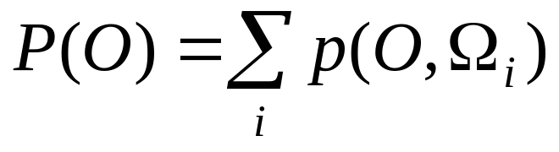
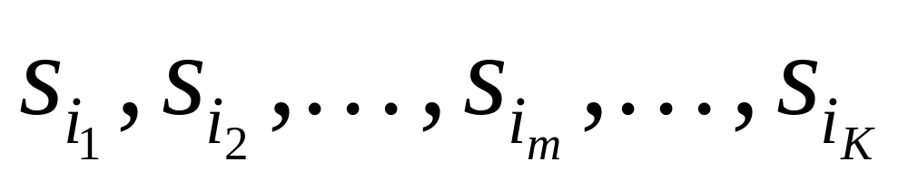
The evaluation Problem
Objective:
find P(O) or P(o₁ o₂ ... o_{K})
where, Ω_{i} is a possible state sequence

Slide 100
The evaluation Problem
Objective:
find P(O) or P(o₁ o₂ ... o_{K})
where, Ω_{i} is a possible state sequence
There are N^{K} possible state sequences!!

Slide 101
The evaluation Problem
Objective:
find P(O) or P(o₁ o₂ ... o_{K})
where, Ω_{i} is a possible state sequence
Complexity is O(N^{K} )

Slide 102
Alternate Solution to The evaluation Problem
Use Forward-Backward HMM algorithms for efficient calculations.
Define the forward variable α_{m}(i) as the joint probability of
  the partial observation sequence o₁ o₂ ... o_{m} and
  the hidden state at time m is s_{i} :
α_{m}(i)= P(o_{1,} o₂ ... o_{m ,} q_{m}= s_{i} )

Slide 103
Trellis representation of an HMM
o₁ o_{m} o_{m+1} o_{K} = Observations
s₁
s₁
s₁
s₁
s₂
s₂
a_{1j}
s₂
s₂
a_{2j}
s_{i}
s_{i}
a_{ij}
s_{i}
s_{j}
a_{Nj}
s_{N}
s_{N}
s_{N}
s_{N}
Time= 1 m m+1 K

Slide 104
Trellis representation of an HMM
o₁ o_{m} o_{m+1} o_{K} = Observations
s₁
α_{m}(1)
s₁
s₁
a_{1j}
s₂
α_{m}(2)
s₂
s₂
a_{2j}
s_{i}
α_{m}(i)
s_{i}
a_{ij}
α_{m+1}(j)
a_{Nj}
s_{N}
α_{m}(N)
s_{N}
s_{N}
Time= 1 m m+1 K

Slide 105
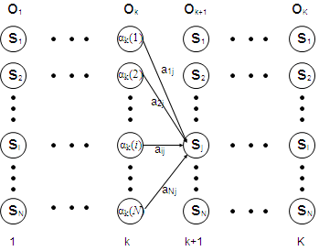
Trellis representation of an HMM
o_{m}
O_{m+1}
Therefore, we can write,
α_{m+1}(j)= P(o₁ o₂ ... o_{m+1 ,} q_{m+1}= s_{j} )
=Σ_{i} P(o₁ o₂ ... o_{m+1 ,}q_{m}= s_{i ,} q_{m+1}=s_{j})
=Σ_{i} P(o₁ o₂ ...o_{m ,} q_{m}= s_{i}) a_{ij} b_{j} (o_{m+1} )
=[Σ_{i} α_{m}(i) a_{ij} ] b_{j} (o_{m+1} ) ,
for 1<=j<=N, 1<=m<=K-1.
m
m+1

Slide 106
Trellis representation of an HMM
o_{m}
O_{m+1}
m
m+1
Now P(o₁ o₂ ... o_{K})
can be written as Σ_{i} P(o₁ o₂ ... o_{K ,} q_{K}= s_{i}) = Σ_{i} α_{K}(i)

Slide 107
Forward recursion for HMM
Initialization:
α₁(i)= P(o_{1 ,} q₁= s_{i} ) = π_{i} b_{i} (o₁) , 1<=i<=N.
Forward recursion:
α_{m+1}(j) = [Σ_{i} α_{m}(i) a_{ij} ] b_{j} (o_{m+1} ) , 1<=j<=N, 1<=m<=K-1.
Termination:
P(o₁ o₂ ... o_{K}) = Σ_{i} α_{K}(i)
Complexity :
N²K operations.

Slide 108
Backward recursion for HMM
Define the backward variable β_{m}(j) as the conditional probability of
  the partial observation sequence o_{m+1} o_{m+2} ... o_{K}
  given that the hidden state at time m is s_{j} :
  β_{m}(j)= P(o_{m+1} o_{m+2} ... o_{K} |q_{m}= s_{j} )

Slide 109
Backward recursion for HMM
Define β_{m}(j) in terms of β_{m+1}(i)’s:
β_{m+1}(i) is the conditional probability of
  the partial observation sequence o_{m+2} o_{m+3} ... o_{K}
  given that the hidden state at time m+1 is s_{i} :
  β_{m+1}(i)= P(o_{m+2} o_{m+3} ... o_{K} |q_{m+1}= s_{i} )

Slide 110
Backward recursion for HMM
Define β_{m}(j) in terms of β_{m+1}(i)’s: the probability of
where β_{m+1}(i)= P(o_{m+2} o_{m+3} ... o_{K} |q_{m+1}= s_{i} )
Now,
β_{m}(j)= P(o_{m+1} o_{m+2} ... o_{K} | q_{m}= s_{j} )
= Σ_{i} P(o_{m+1} o_{m+2} ... o_{K ,} q_{m+1}= s_{i} | q_{m}= s_{j} )
= Σ_{i} P(o_{m+2} o_{m+3} ... o_{K} | q_{m+1}= s_{i}) a_{ji} b_{i} (o_{m+1} )
= Σ_{i} β_{m+1}(i) a_{ji} b_{i} (o_{m+1} ) , 1<=j<=N, 1<=m<=K-1.

Slide 111
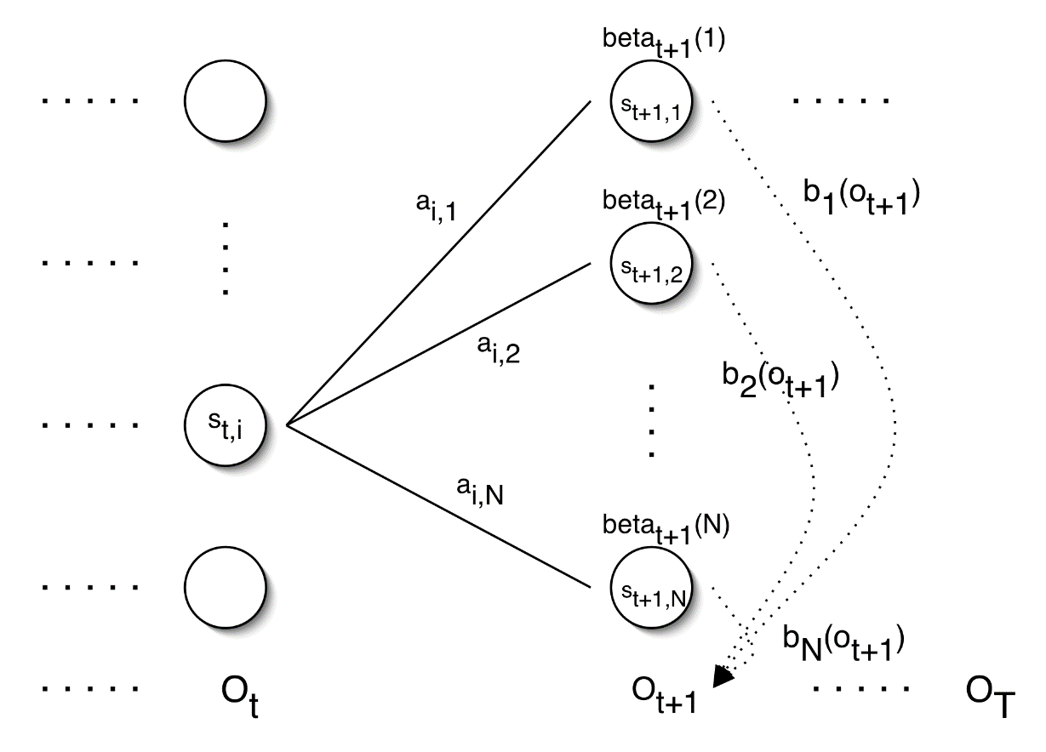
Backward recursion for HMM
= Σ_{i} P(o_{m+1} o_{m+2} ... o_{K ,} q_{m+1}= s_{i} | q_{m}= s_{j} )
= Σ_{i} P(o_{m+2} o_{m+3} ... o_{K} | q_{m+1}= s_{i}) a_{ji} b_{i} (o_{m+1} )
= Σ_{i} β_{m+1}(i) a_{ji} b_{i} (o_{m+1} ) , 1<=j<=N, 1<=m<=K-1.
β_{m+1}(1)
b₁(O_{m+1})
β_{m+1}(2)
b₂(O_{m+1})
β_{m}(j)
β_{m+1}(N)
b_{N}(O_{m+1})
o_{m}
O_{m+1}
o_{K}

Slide 112
Backward recursion for HMM
Initialization:
β_{K}(i)= 1 , 1<=i<=N.
Backward recursion:
β_{m}(j)= Σ_{i} β_{m+1}(i) a_{ji} b_{i} (o_{m+1} ) , 1<=j<=N, 1<=m<=K-1.
Termination:
P(o₁ o₂ ... o_{K}) = Σ_{i} P(o₁ o₂ ... o_{K ,} q₁= s_{i}) =
Σ_{i} P(o₁ o₂ ... o_{K} |q₁= s_{i}) P(q₁= s_{i}) = Σ_{i} β₁(i) b_{i} (o₁) π_{I}

Slide 113
Main issues using HMMs (2)
Decoding problem.
Given the HMM M=(A, B, π) and the observation sequence O=o₁ o₂ ... o_{K} , calculate the most likely sequence of hidden states s_{i} that produces this observation sequence O.
O=o₁...o_{K} denotes a sequence of observations o_{k}∈{v₁,…,v_{M}}.

Slide 114
Decoding problem
Given the HMM M=(A, B, π) and the observation sequence O=o₁ o₂ ... o_{K} , calculate the most likely sequence of hidden states s_{i} that produces this observation sequence O.
We want to find:
the state sequence Q= q₁…q_{K} maximizing
P(Q | o₁ o₂ ... o_{K} )

Slide 115
Decoding problem
Given the HMM M=(A, B, π) and the observation sequence O=o₁ o₂ ... o_{K} , calculate the most likely sequence of hidden states s_{i} that produces this observation sequence O.
We want to find:
the state sequence Q= q₁…q_{K} maximizing
P(Q | o₁ o₂ ... o_{K} )
or, equivalently
P(Q , o₁ o₂ ... o_{K} )

Slide 116
Decoding problem
Find max value of P(Q , o₁ o₂ ... o_{K} )
Brute Force Method:
Try for all possible sequences of states
N^{K} possible sequences for Q

Slide 117
Decoding problem
Use efficient Viterbi algorithm instead
Define variable δ_{m}(i) as the maximum probability of
  producing observation sequence o₁ o₂ ... o_{m}
  when moving along any hidden state sequence q₁… q_{m-1} and
  getting into q_{m}= s_{i}

Slide 118
Decoding problem
Use efficient Viterbi algorithm instead
Define variable δ_{m}(i) as the maximum probability of
  producing observation sequence o₁ o₂ ... o_{m}
  when moving along any hidden state sequence q₁… q_{m-1} and
  getting into q_{m}= s_{i}
Therefore, δ_{m}(i) = max P(q₁… q_{m-1} , q_{m}= s_{i} , o₁ o₂ ... o_{m})
where max is taken over all possible paths q₁… q_{m-1} .

Slide 119
Decoding problem
General idea:
if best path ending in q_{m}= s_{j} goes through q_{m-1}= s_{i} then it should coincide with best path ending in q_{m-1}= s_{i} .
q_{m-1} q_{m}
s₁
a_{1j}
s_{i}
s_{j}
a_{ij}
s_{N}
a_{Nj}

Slide 120
Decoding problem
General idea:
if best path ending in q_{m}= s_{j} goes through q_{m-1}= s_{i} then it should coincide with best path ending in q_{m-1}= s_{i} .
q_{m-1} q_{m}
s₁
a_{1j}
s_{i}
s_{j}
a_{ij}
s_{N}
a_{Nj}
δ_{m}(j) = max P(q₁… q_{m-1} , q_{m}= s_{j} , o₁ o₂ ... o_{m})

Slide 121
Decoding problem
General idea:
if best path ending in q_{m}= s_{j} goes through q_{m-1}= s_{i} then it should coincide with best path ending in q_{m-1}= s_{i} .
q_{m-1} q_{m}
s₁
a_{1j}
s_{i}
s_{j}
a_{ij}
s_{N}
a_{Nj}
δ_{m}(j) = max P(q₁… q_{m-1} , q_{m}= s_{j} , o₁ o₂ ... o_{m})
= max_{i} [ a_{ij} b_{j} (o_{m} ) max P(q₁… q_{m-1}= s_{i} , o₁ o₂ ... o_{m-1}) ]

Slide 122
Decoding problem
General idea:
if best path ending in q_{m}= s_{j} goes through q_{m-1}= s_{i} then it should coincide with best path ending in q_{m-1}= s_{i} .
q_{m-1} q_{m}
s₁
a_{1j}
s_{i}
s_{j}
a_{ij}
s_{N}
a_{Nj}
δ_{m}(j) = max P(q₁… q_{m-1} , q_{m}= s_{j} , o₁ o₂ ... o_{m})
= max_{i} [ a_{ij} b_{j} (o_{m} ) max P(q₁… q_{m-1}= s_{i} , o₁ o₂ ... o_{m-1}) ]
= max_{i} [ a_{ij} b_{j} (o_{m} ) δ_{m-1}(i)]

Slide 123
Decoding problem
General idea:
if best path ending in q_{m}= s_{j} goes through q_{m-1}= s_{i} then it should coincide with best path ending in q_{m-1}= s_{i} .
q_{m-1} q_{m}
s₁
a_{1j}
s_{i}
s_{j}
a_{ij}
s_{N}
a_{Nj}
To backtrack best path, keep info that predecessor of s_{j} was s_{i}.

Slide 124
Decoding problem
Initialization:
δ₁(i) = max P(q₁= s_{i} , o₁) = π_{i} b_{i} (o₁) , 1<=i<=N
Forward recursion:
δ_{m}(j) = max_{i} [ a_{ij} b_{j} (o_{m} ) δ_{m-1}(i) ] , 1<=j<=N, 2<=m<=K.
Termination: choose best path ending at time K
max_{i} [ δ_{K}(i) ]
Backtrack best path.

Slide 125
Issues in HMMs (3)
Learning/Training problem.
Given some training observation sequences O=o₁ o₂ ... o_{K} and general structure of HMM (numbers of hidden and visible states), determine HMM parameters M=(A, B, π) that best fit training data.
O=o₁..., o_{m},...,o_{K} denotes a sequence of observations
where, o_{m}∈{v₁,…,v_{M}}.

Slide 126
Learning/Training Problem
Given some training observation sequences O=o₁ o₂ ... o_{K} and general structure of HMM (numbers of hidden and visible states), determine HMM parameters M=(A, B, π) that best fit training data.
There is no algorithm producing optimal parameter values.

Slide 127
Learning/Training Problem
Given some training observation sequences O=o₁ o₂ ... o_{K} and general structure of HMM (numbers of hidden and visible states), determine HMM parameters M=(A, B, π) that best fit training data.
There is no algorithm producing optimal parameter values.
Use iterative Expectation-Maximization (EM) algorithm to find local maximum of P(O | M) - Baum-Welch algorithm.

Slide 128
Learning/Training Problem
Idea of EM :
Initialization: Assume initial value of A, B, π
and calculate P(O | M)
E-step:
Estimate new values of the model parameters: A, B, π
from the previous values of A, B, π
M-step:
Find P(O | M) with the new values of A, B, π
Repeat these steps until P(O | M) declines

Slide 129
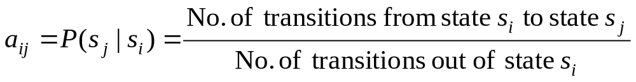
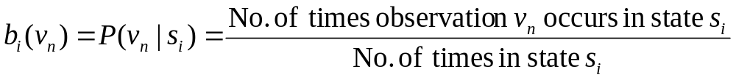

Learning/Training Problem
we need to calculate the following parameters:

Slide 130


Baum-Welch algorithm
the algorithm estimates the expected value::

Slide 131
Baum-Welch algorithm
Define variable ξ_{m}(i,j) as the probability of being in state s_{i} at time m and in state s_{j} at time m+1, given the observation sequence o₁ o₂ ... o_{K} .
ξ_{m}(i,j)= P(q_{m}= s_{i} , q_{m+1}= s_{j} | o₁ o₂ ... o_{K})

Slide 132
Baum-Welch algorithm
Define variable ξ_{m}(i,j) as the probability of being in state s_{i} at time m and in state s_{j} at time m+1, given the observation sequence o₁ o₂ ... o_{K} .
ξ_{m}(i,j)= P(q_{m}= s_{i} , q_{m+1}= s_{j} | o₁ o₂ ... o_{K})
P(q_{m}= s_{i} , q_{m+1}= s_{j} , o₁ o₂ ... o_{K})
P(o₁ o₂ ... o_{K})
ξ_{m}(i,j)=

Slide 133
Baum-Welch algorithm
Define variable ξ_{m}(i,j) as the probability of being in state s_{i} at time m and in state s_{j} at time m+1, given the observation sequence o₁ o₂ ... o_{K} .
ξ_{m}(i,j)= P(q_{m}= s_{i} , q_{m+1}= s_{j} | o₁ o₂ ... o_{K})
P(q_{m}= s_{i} , q_{m+1}= s_{j} , o₁ o₂ ... o_{K})
P(o₁ o₂ ... o_{K})
ξ_{m}(i,j)=
P(q_{m}= s_{i} , o₁ o₂ ... o_{m}) a_{ij} b_{j} (o_{m+1} ) P(o_{m+2} ... o_{K} | q_{m+1}= s_{j} )
P(o₁ o₂ ... o_{K})
=

Slide 134
Baum-Welch algorithm
Define variable ξ_{m}(i,j) as the probability of being in state s_{i} at time m and in state s_{j} at time m+1, given the observation sequence o₁ o₂ ... o_{K} .
ξ_{m}(i,j)= P(q_{m}= s_{i} , q_{m+1}= s_{j} | o₁ o₂ ... o_{K})
P(q_{m}= s_{i} , o₁ o₂ ... o_{m}) a_{ij} b_{j} (o_{m+1} ) P(o_{m+2} ... o_{K} | q_{m+1}= s_{j} )
P(o₁ o₂ ... o_{K})
=
α_{m}(i) a_{ij} b_{j} (o_{m+1} ) β_{m+1}(j)
P(o₁ o₂ ... o_{K})
=

Slide 135
Baum-Welch algorithm
Define variable γ_{m}(i) as the probability of being in state s_{i} at time m, given the observation sequence o₁ o₂ ... o_{K} .
γ_{m}(i)= P(q_{m}= s_{i} | o₁ o₂ ... o_{K})
P(q_{m}= s_{i} , o₁ o₂ ... o_{k})
P(o₁ o₂ ... o_{k})
α_{m}(i) β_{m}(i)
P(o₁ o₂ ... o_{k})
γ_{m}(i)=
=

Slide 136
Baum-Welch algorithm
We calculated ξ_{m}(i,j) = P(q_{m}= s_{i} , q_{m+1}= s_{j} | o₁ o₂ ... o_{K})
and γ_{m}(i)= P(q_{m}= s_{i} | o₁ o₂ ... o_{K})
Expected number of transitions from state s_{i} to state s_{j}
= Σ_{m} ξ_{m}(i,j)
Expected number of transitions out of state s_{i} = Σ_{m} γ_{m}(i)
Expected number of times observation v_{n} occurs in state s_{i} =
= Σ_{m} γ_{m}(i) , m is such that o_{m}= v_{n}

Slide 137




Baum-Welch algorithm: E-Step
Estimate the expected values as
Σ_{m} ξ_{m}(i,j)
Σ_{m} γ_{m}(i)
=

Slide 138
Learning/Training Algorithm
Initialization: Assume initial value of A, B, π
and calculate P(O | M)
E-step:
Estimate new values of the model parameters: A, B, π
from the previous values of A, B, π
M-step:
Find P(O | M) with the new values of A, B, π
Repeat these steps until P(O | M) declines

